Slide 1

Dumbways Bootcamp Week 4
Anjar Daniswara

Slide 2
Monitoring & Ansible
Setup Monitoring Server
Connect Multiple Server to Prometheus
Deploy PHP Apps in Cpanel
Setup Server With Ansible

Slide 3
Setup Monitoring Server

Slide 4



Node Exporter
Node Exporter

Slide 5
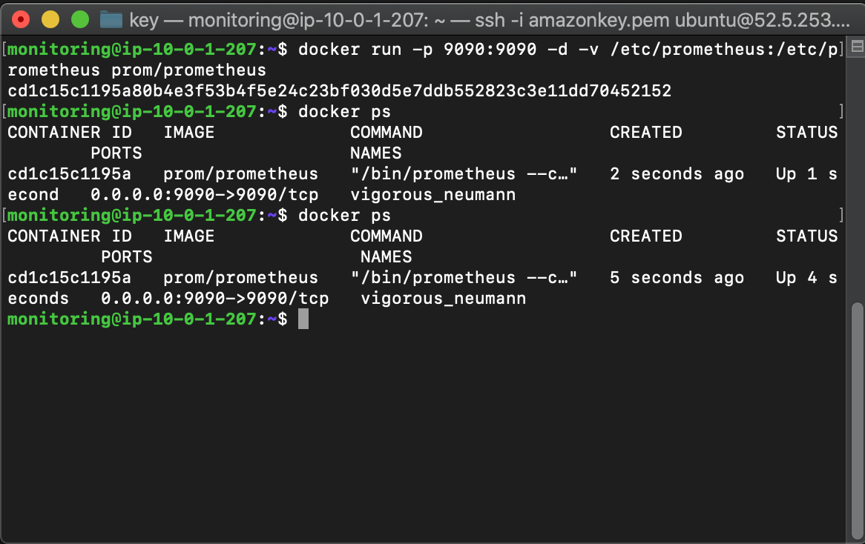
Install Prometheus In Docker

Slide 6
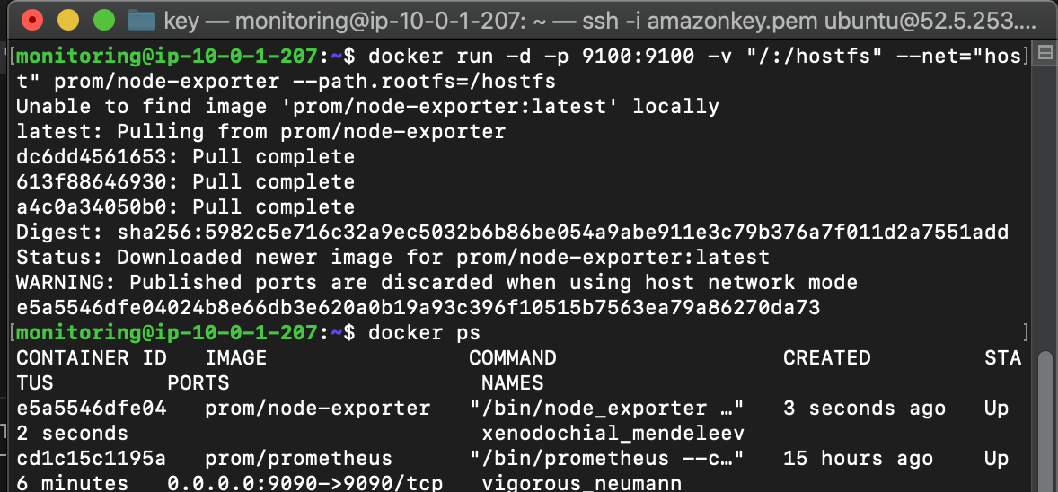
Install Node Exporter in Docker

Slide 7
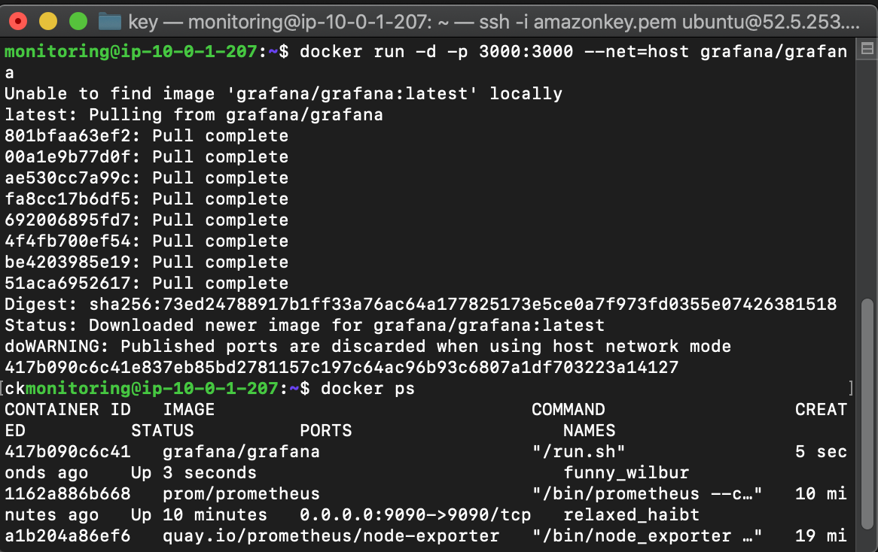
Install Grafana in Docker

Slide 8
Connect Multiple Server to Prometheus

Slide 9
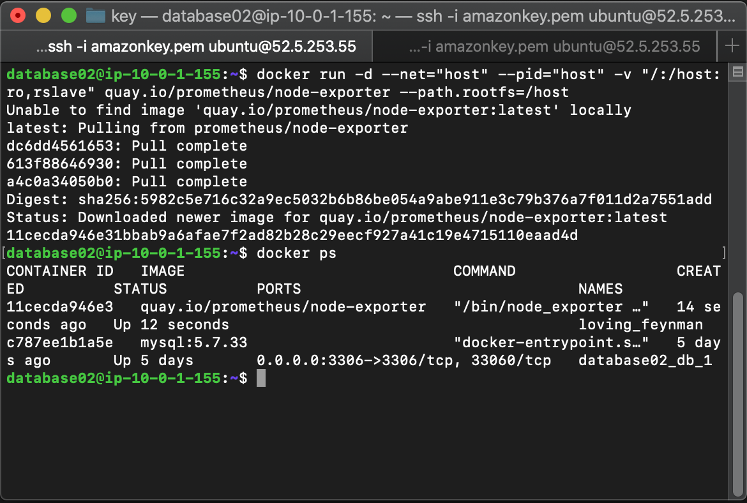
Install Node Exporter to Target Server

Slide 10
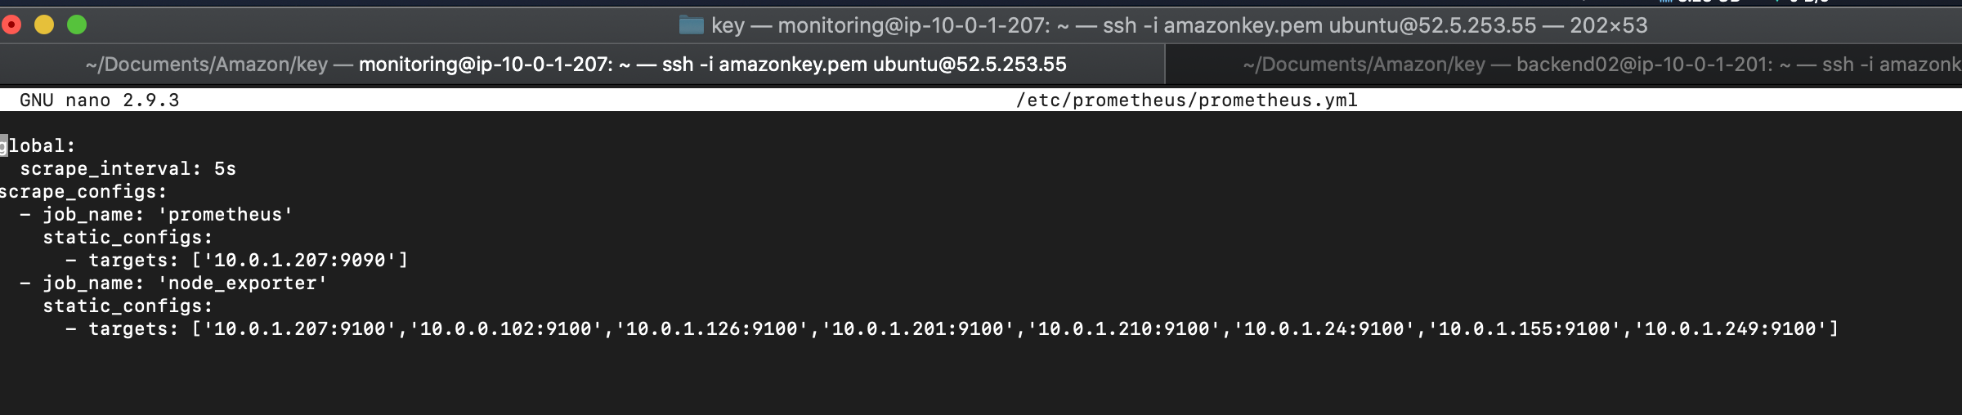
Edit Prometheus.yml

Slide 11
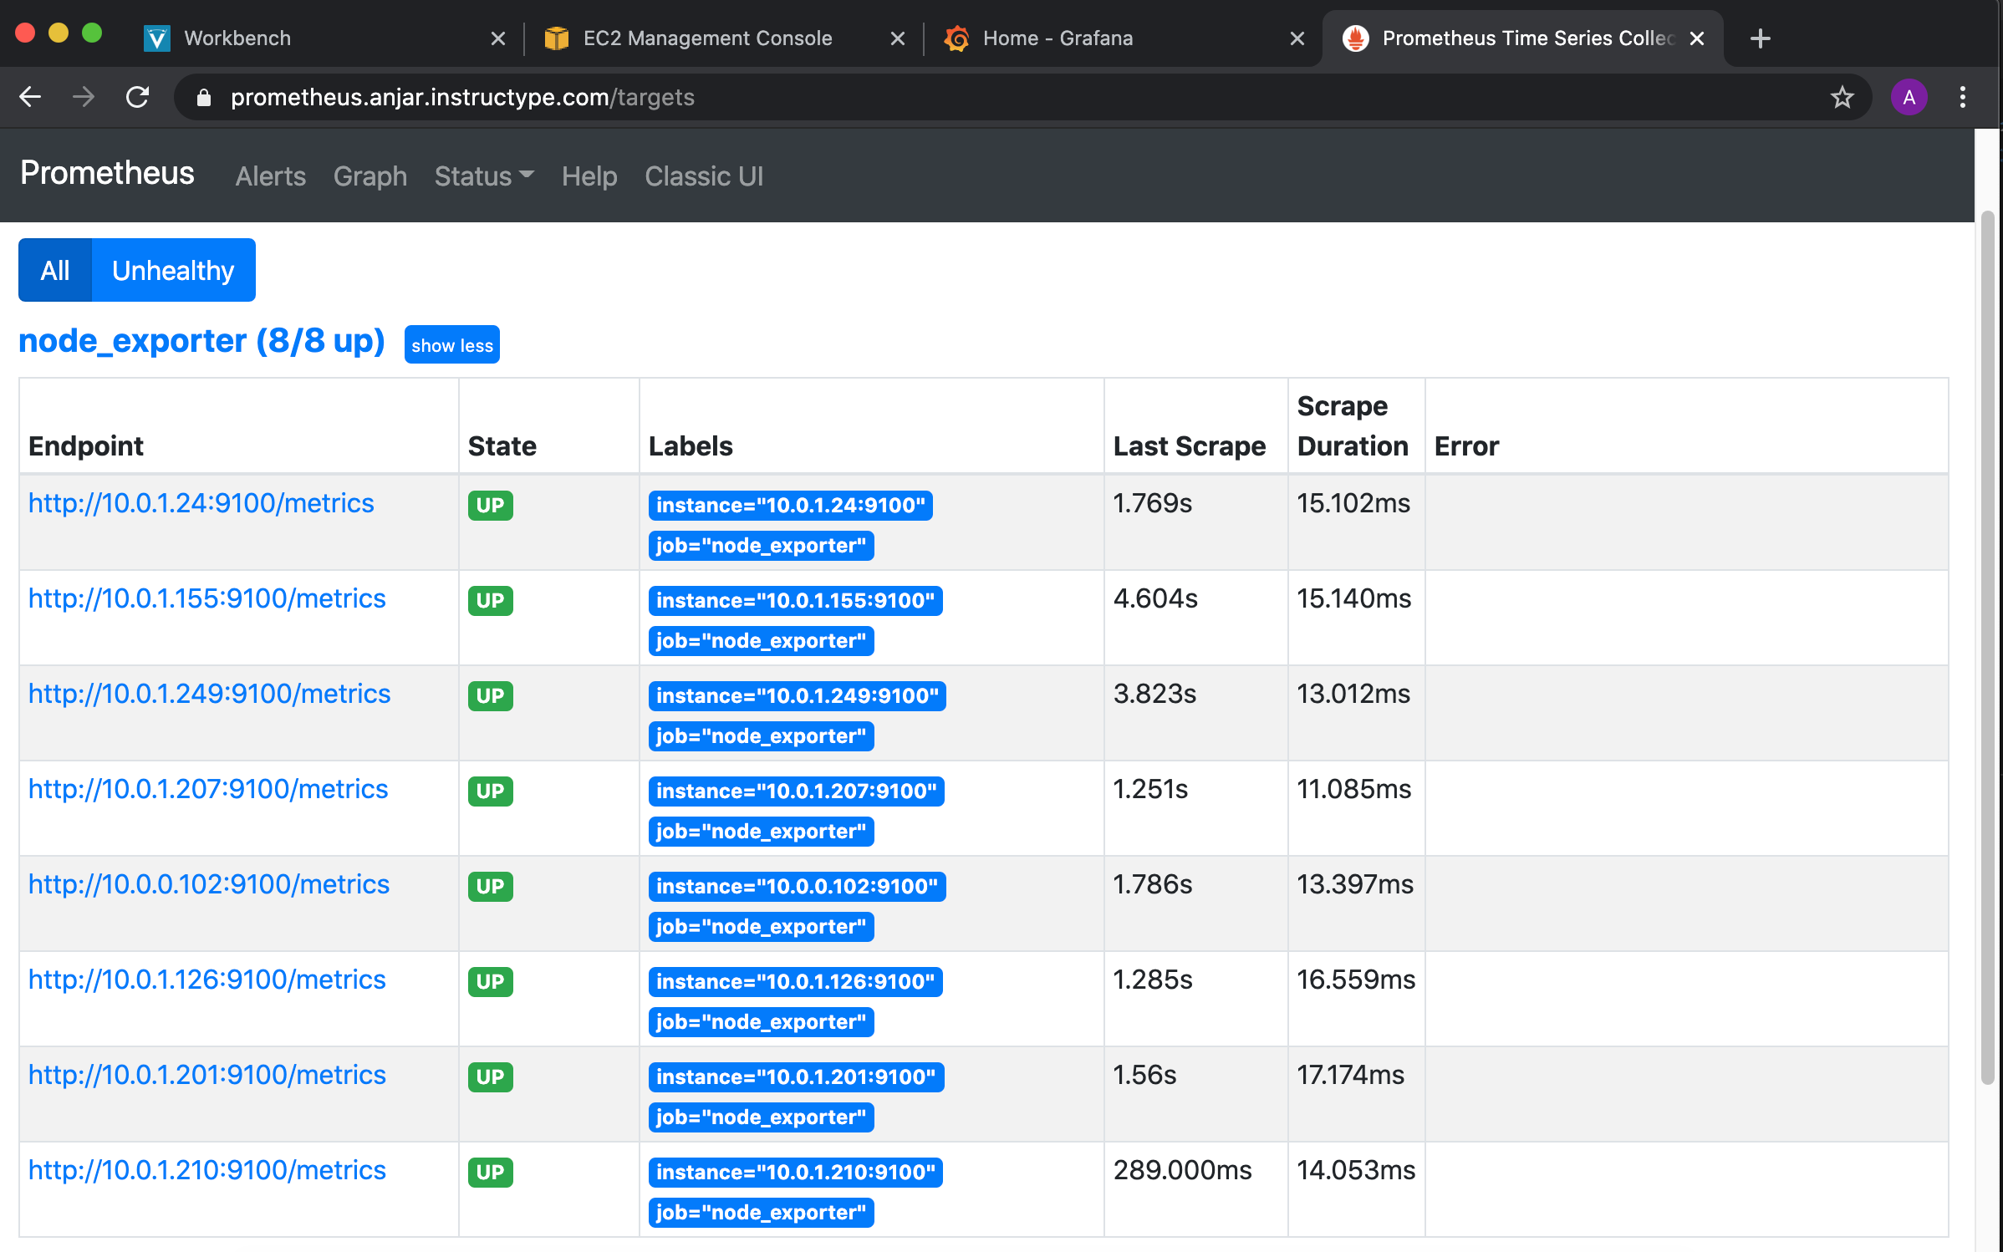
Check In Prometheus

Slide 12
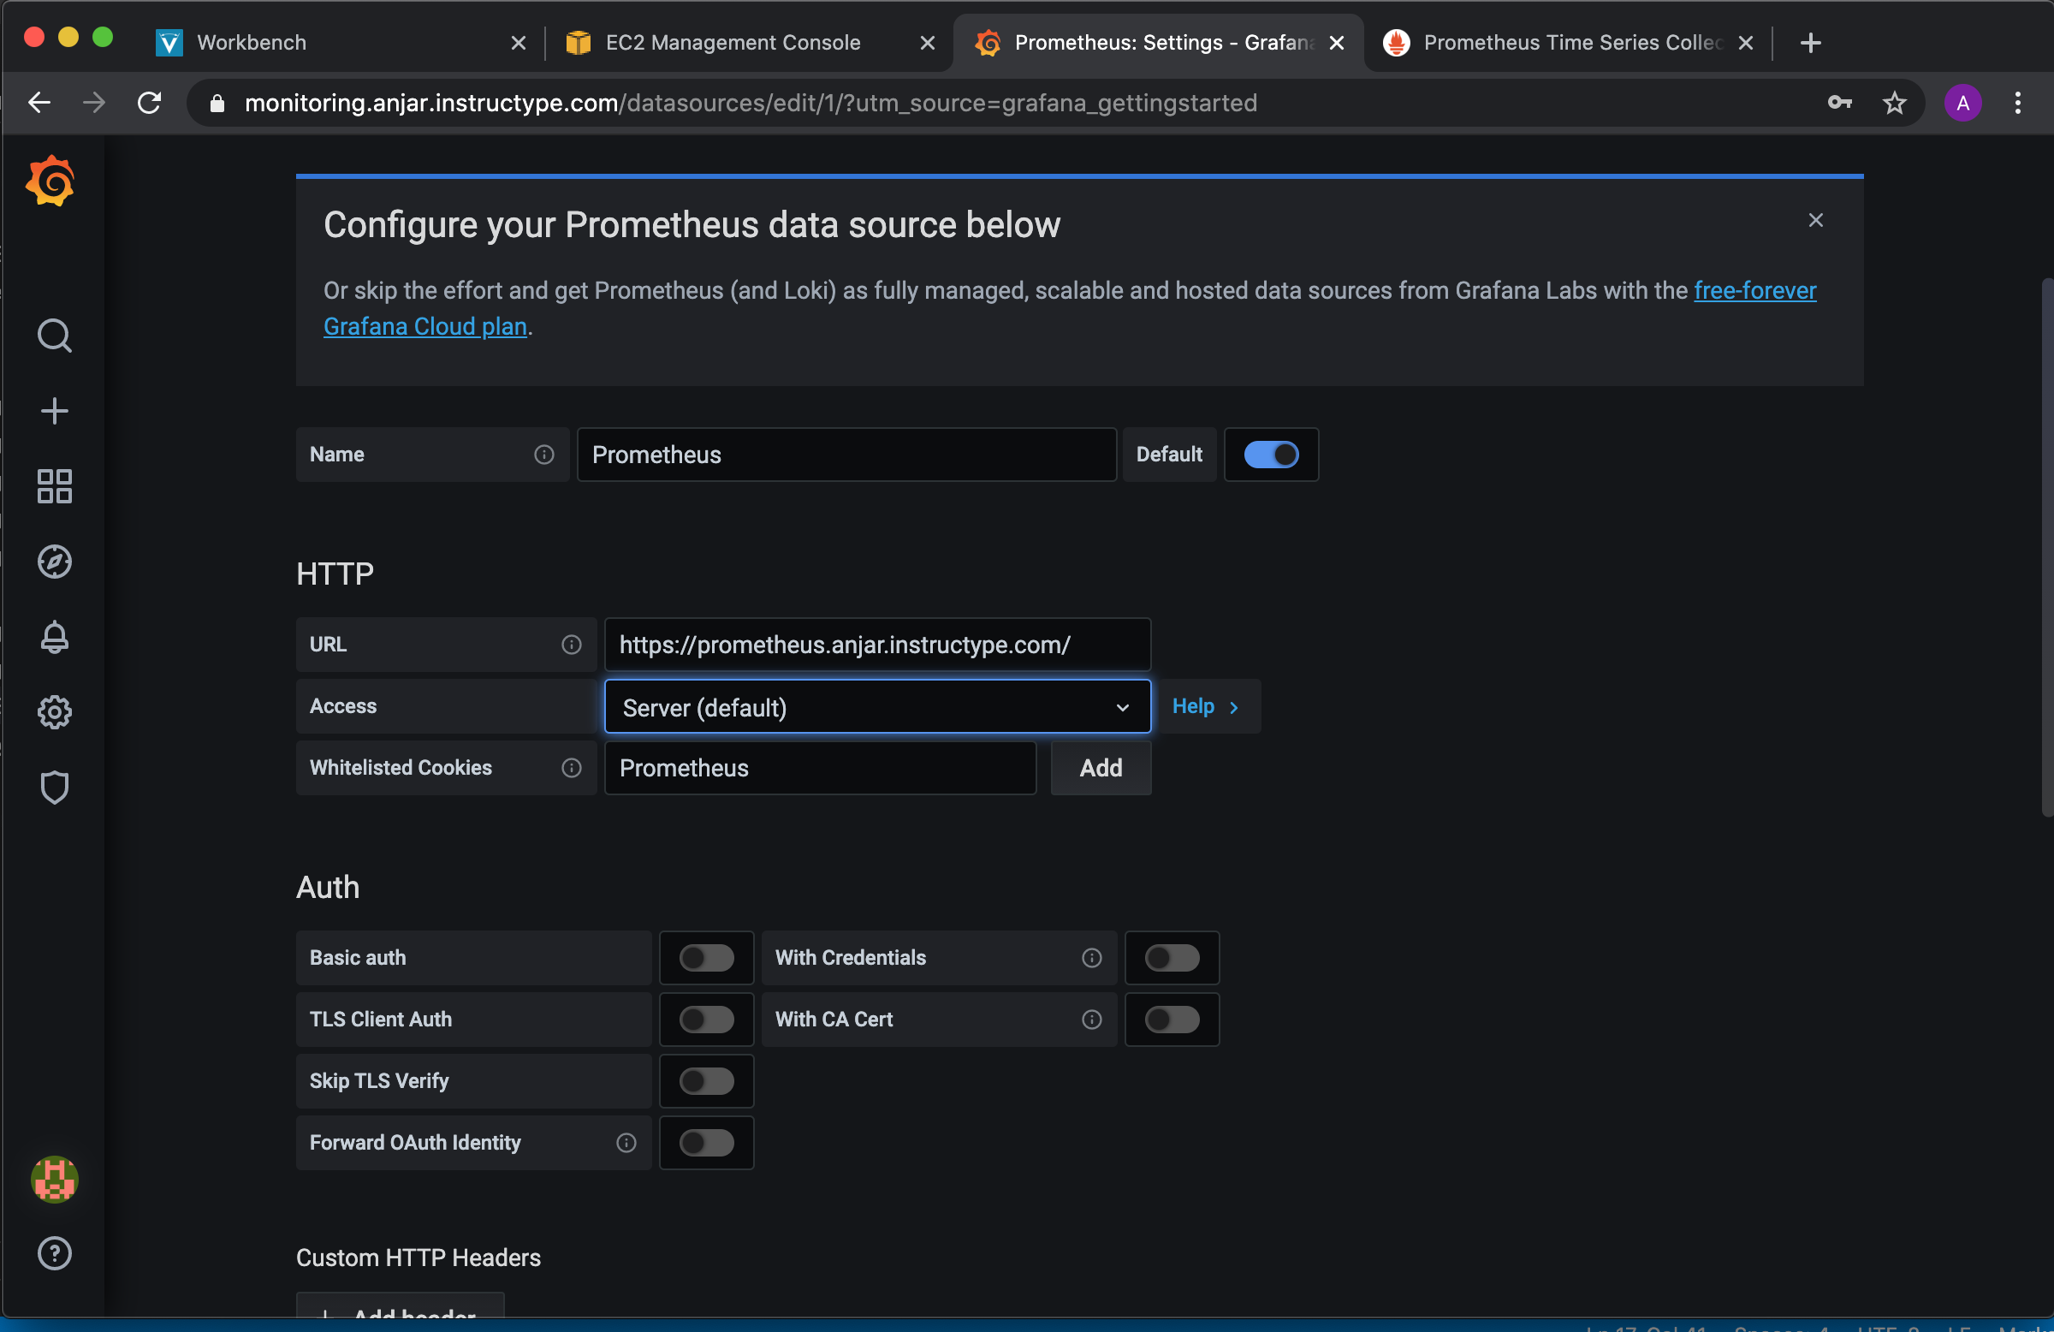
Add Resource to Grafana

Slide 13
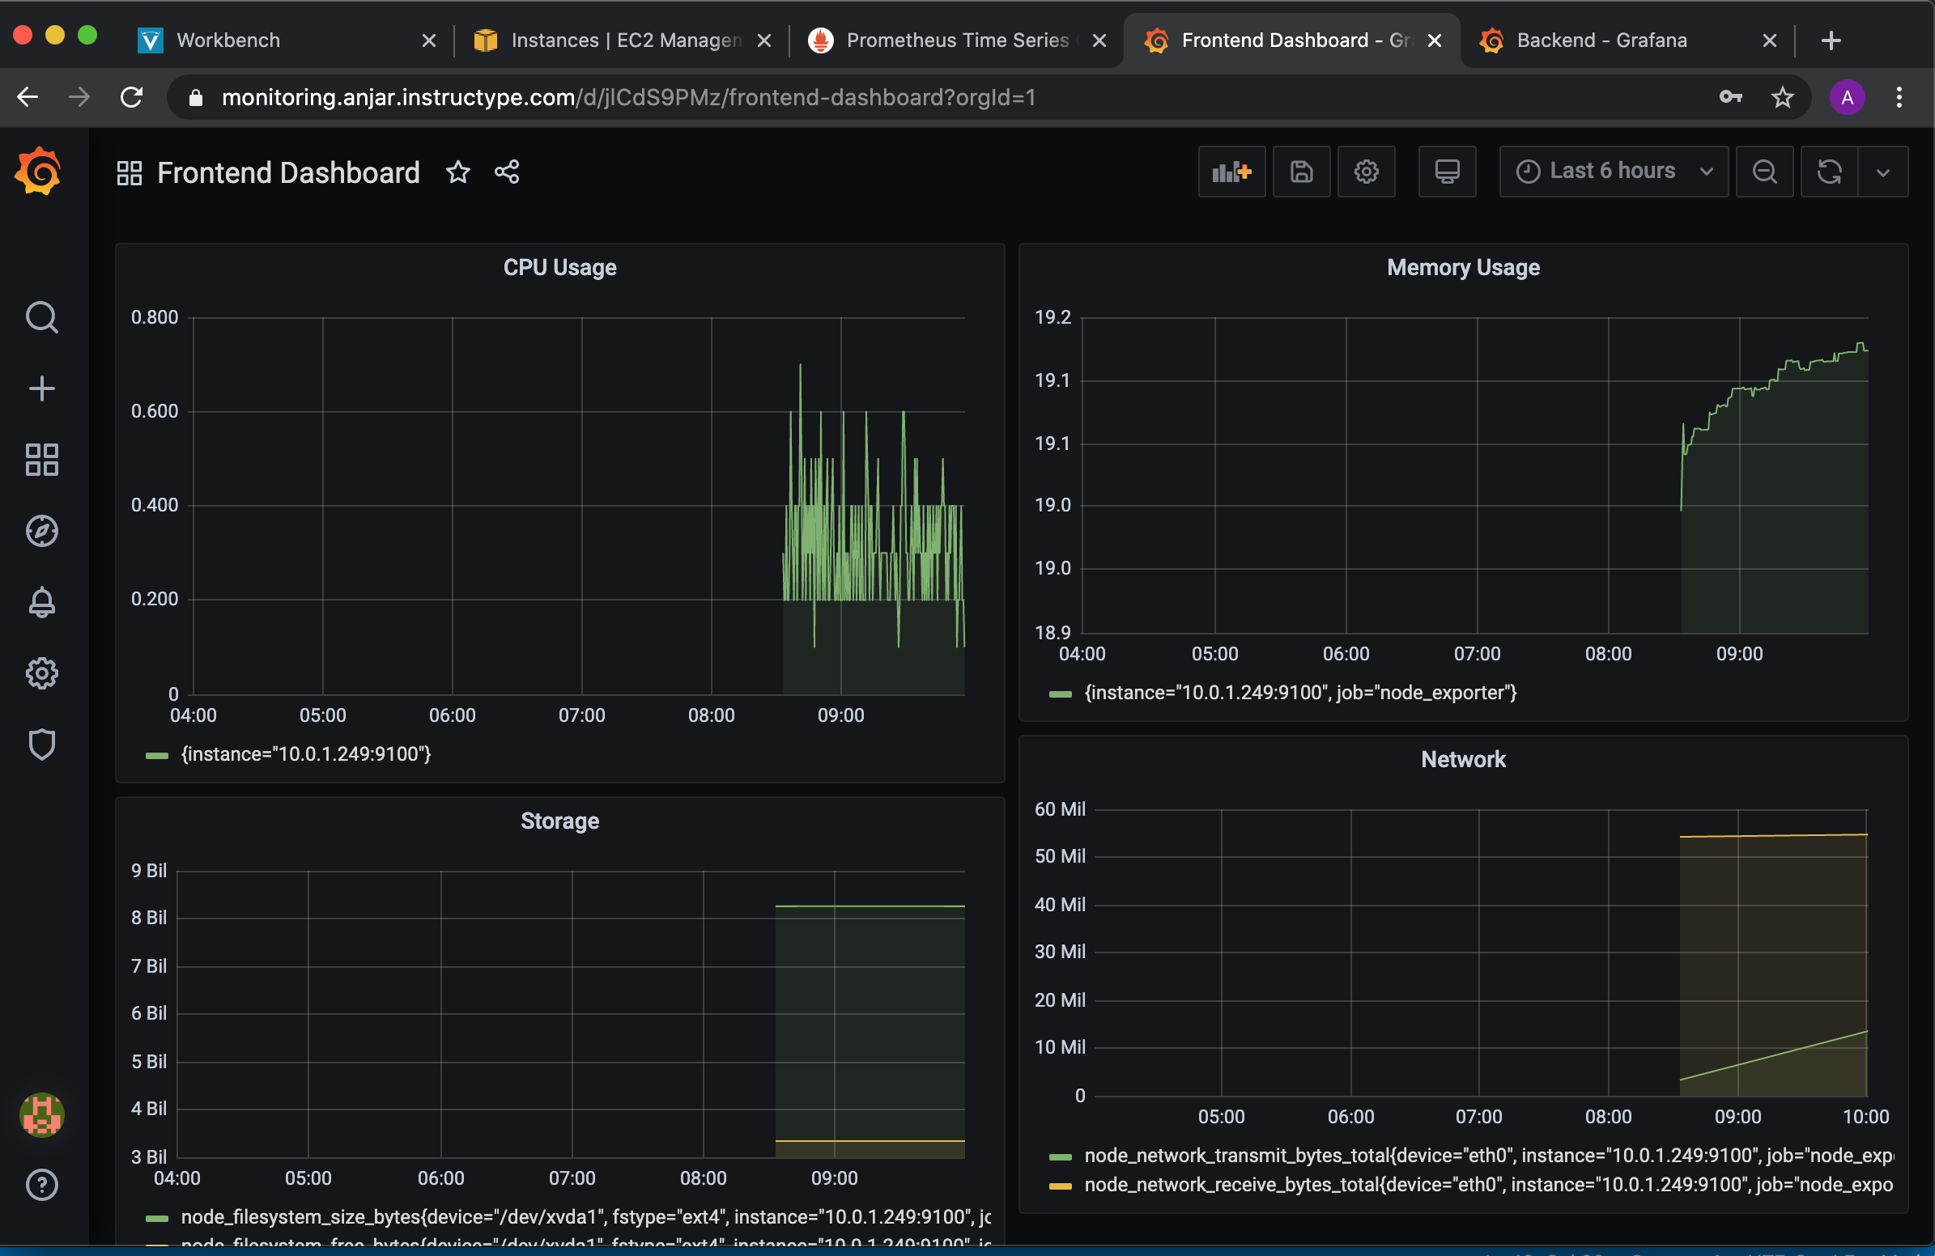
Create Dashboard

Slide 14
Deploy Php Apps in cPanel

Slide 15
Deploy PHP Application in cPanel
Sign Up
Sign Up Byethost
Download
Download CMS Vanilla Forum and Extract
Transfer
Transfer with Filezilla
Create
Create Database in cPanel
Sign Up
Sign Up Infinityfree and Add Domain SSL
Add
Add SSL

Slide 16
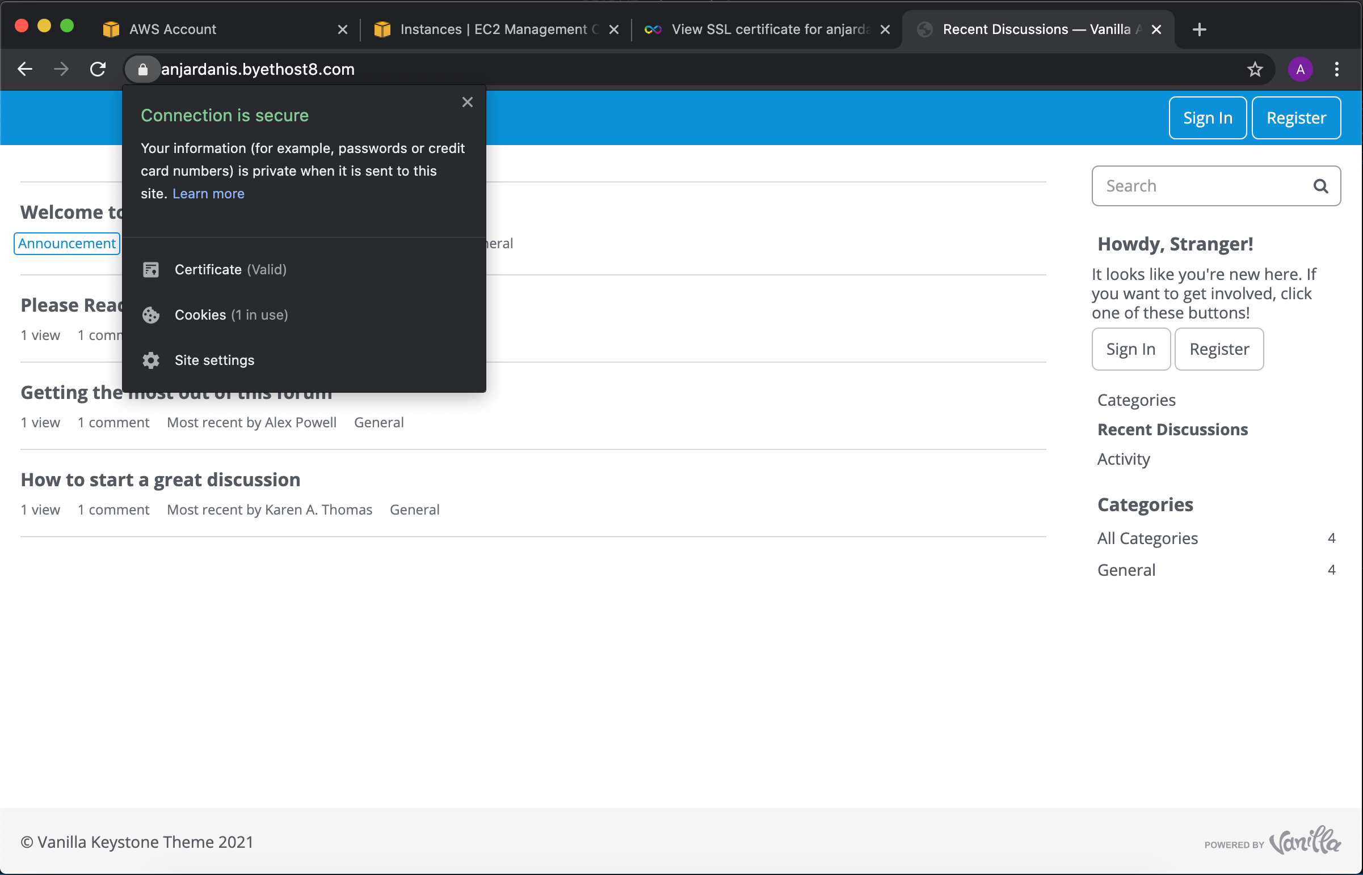
Output

Slide 17
Setup Server with Ansible

Slide 18
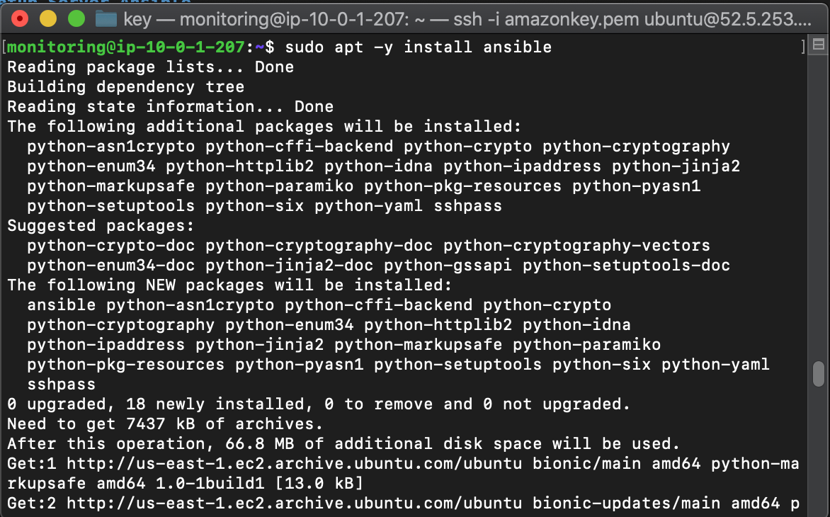
Install Ansible

Slide 19
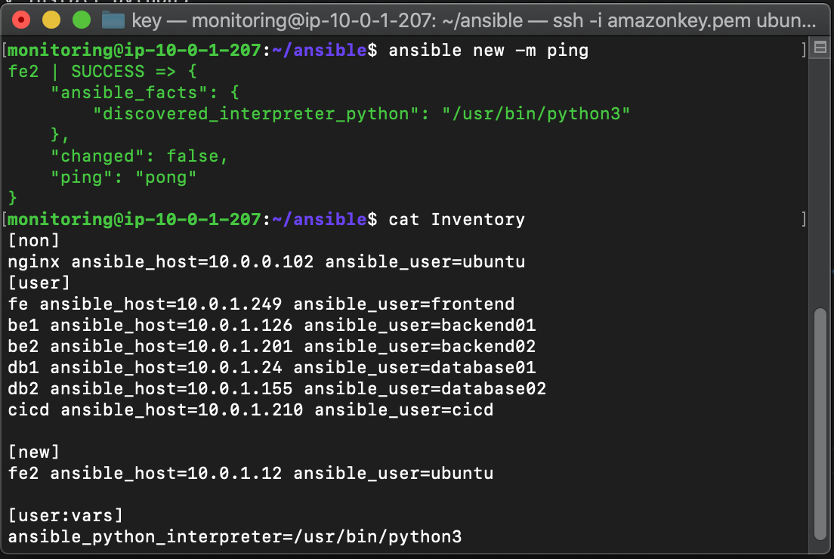
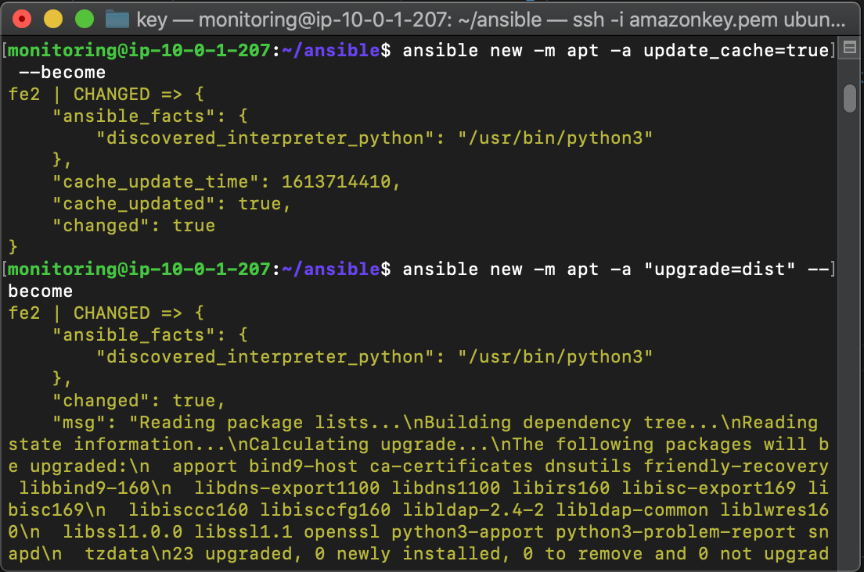

Slide 20
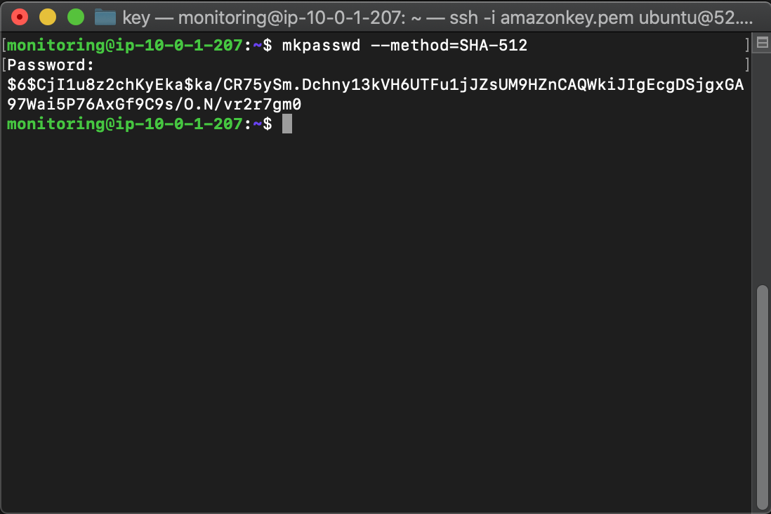
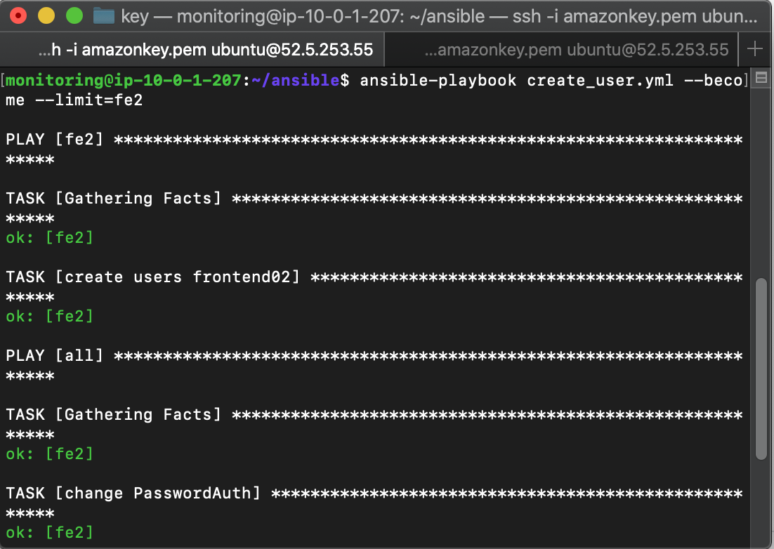

Slide 21
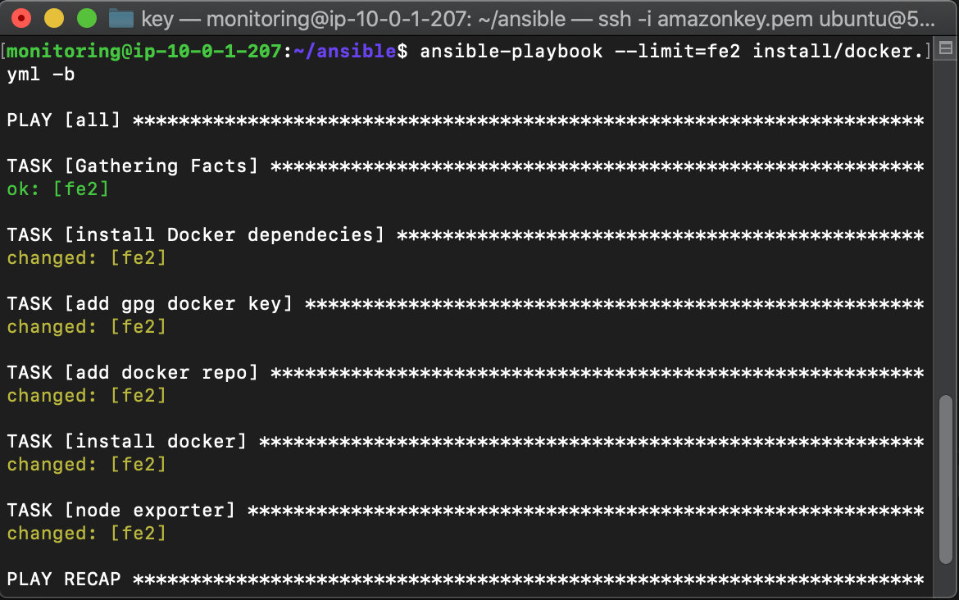

Slide 22
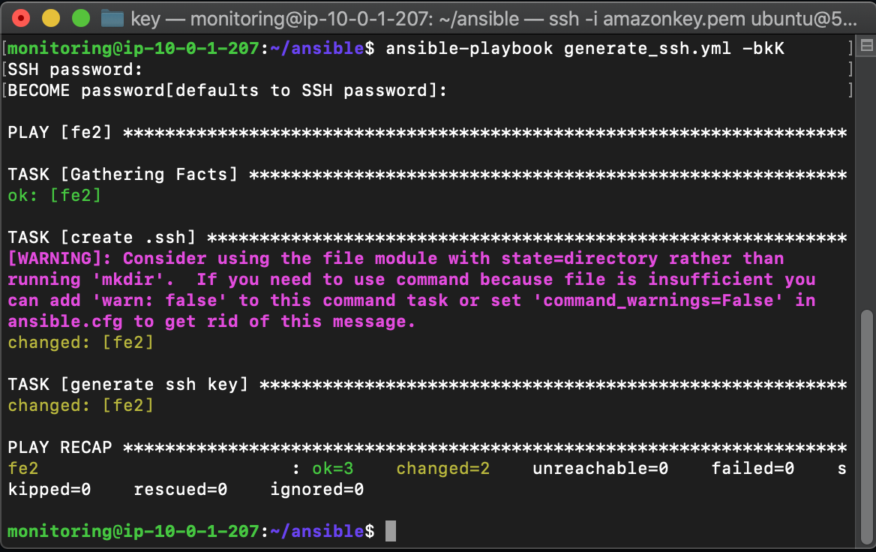
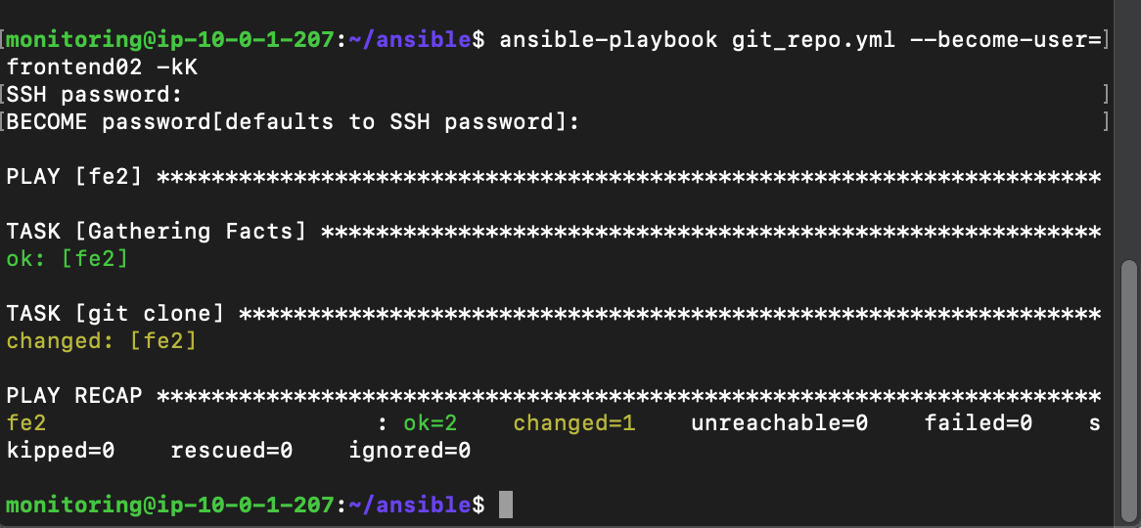

Slide 23
